Slide 1

SPACE INVADER GAME
USING PYGAME

Slide 2
ABOUT
Space Invaders is a two-dimensional fixed shooter game in which the player controls a ship with lasers by moving it horizontally across the bottom of the screen and firing at descending aliens.
Aim: to defeat aliens that move horizontally back and forth across the screen as they advance towards the bottom of the screen. The player defeats an alien, and earns points, by shooting it with the laser cannon.

Slide 3
PYGAME
Pygame is a set of Python modules designed for writing video games. Pygame adds functionality on top of the excellent SDL library. This allows you to create fully featured games and multimedia programs in the python language.
More: Truly portable
It's Simple
It's is free
You control your main loop

Slide 4
Basics
Initializing Pygame-pygame.init()
surface-pygame.display.set_mode()
Loading Image -image.load()
pixel format-surface = pygame.image.load('foo.png').convert()
Updating display-pygame.display.update()
Sound-from pygame import mixer

Slide 5
More Basics
Game Loop-
crashed = False
while not crashed:
for event in pygame.event.get():
if event.type == pygame.QUIT:
crashed = True
print(event)
pygame.display.update()
clock.tick(60)

Slide 6
Space Invader Game
Characters Involved:
Player
Enemy
Bullets
Text display:
Scores
Game Over
Motion and Movements
Player Movement
Enemy Movement
Bullet Movement
Algorithm
Collision Detection Algorithm

Slide 7
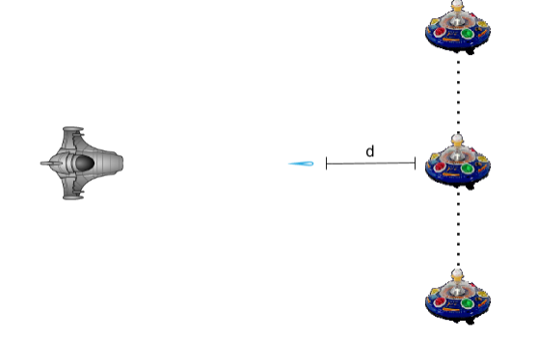

Collision Detection
The simple and straight forward concept is to match up the coordinates of the two objects and set a condition for the happening of collision.

Slide 8
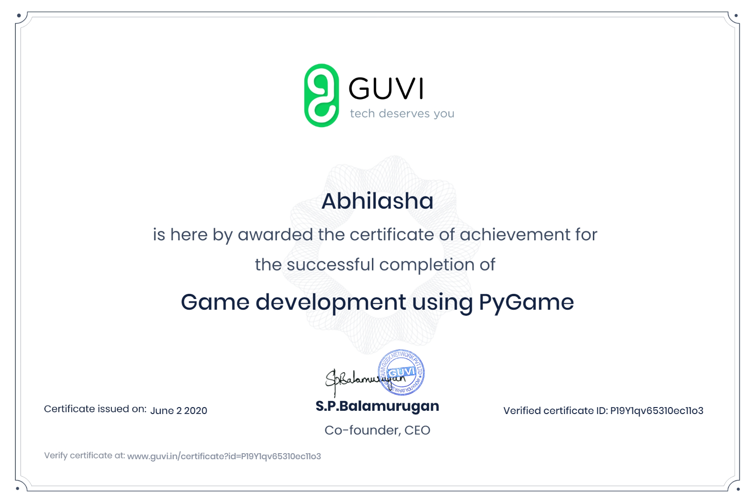

Slide 9
